Slide 1
Hand Gesture controlled car using Arduino

Slide 2
The components we are using are as follows :
Arduino UNO
Arduino Nano
L298N motor driver
nRf24L01 Modules
18650 Lithium ion batteries
Accelerometer(MPU6050)

Slide 3
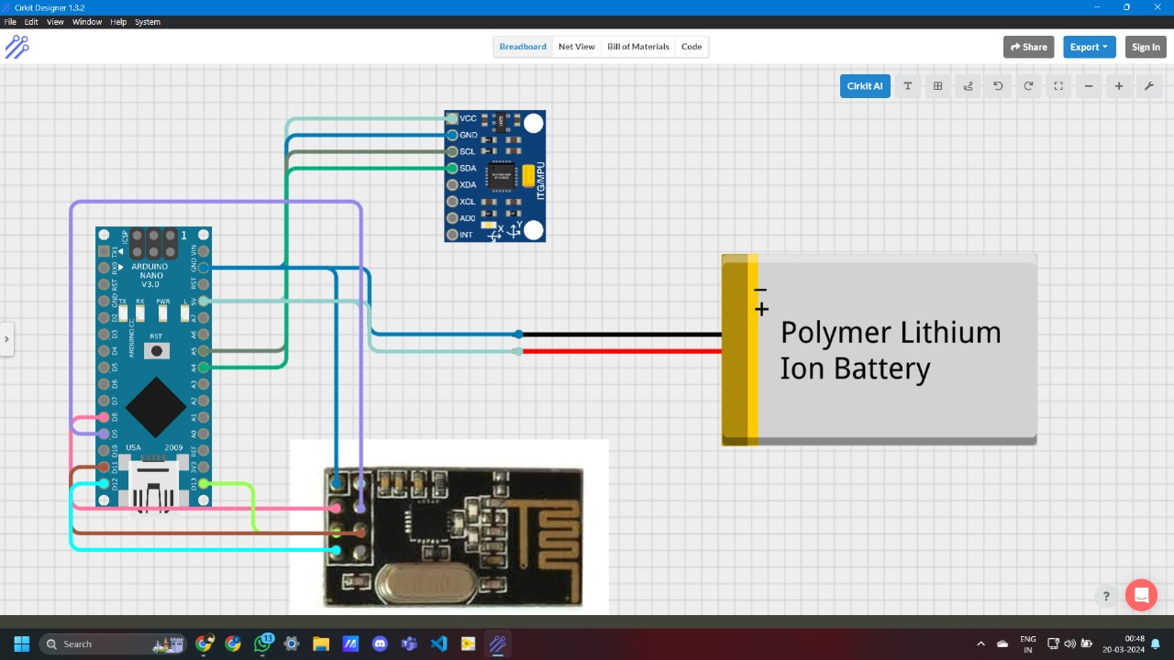
Circuit Diagram of transmitter

Slide 4
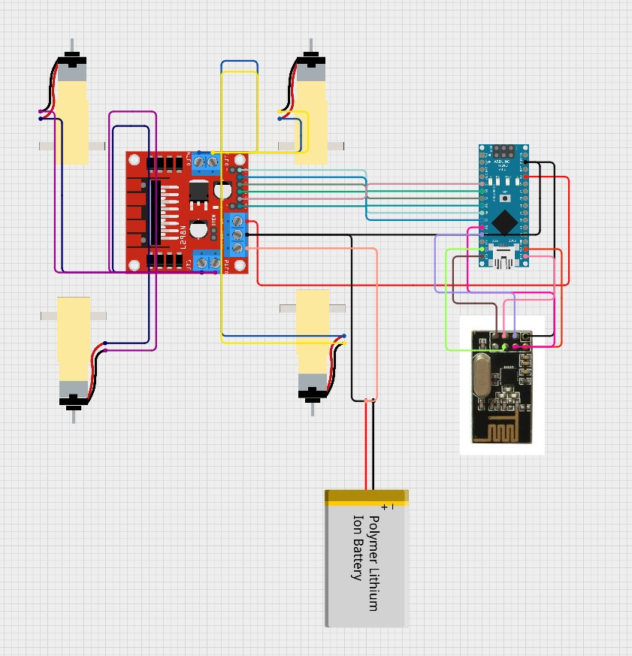
Circuit diagram of receiver

Slide 5
Start
Accelerometer
Arduino Nano
Obtaining values along x y z direction
RF receiver
RF transmitter
Arduino UNO
Checking the values
Forward
Backward
Left
Right
Movement of car
L298N motor shield

